Slide 1

Mapping
Real-Time Tweets
For Sensing &
Proactive Response

Slide 2
SCOPE
Introduction
What is the problem we are trying to solve
How are we going to solve it
Why are we doing this
Method
Limitations/challenges
Future enhancements

Slide 3
INTRODUCTION
Twitter has become an outlet for many different types of breaking news
Eg. political, environmental, public disorder or sports related
Twitter is increasingly being used for sharing views and sentiments about issues of concern to users
Hence, there is a large volume of information that is to be mined

Slide 4
What is the problem we are trying to solve
We want to know if there are any negative sentiments that have the potential to incite social tensions and stir up public disorder or related incidents
Existing tools are available
We want to know where the users are largely located based on their tweets
Our Tool
We want to detect it early to prevent the situation from escalating
This information on hotspots will serve as an additional sensing tool for a more proactive response and engagement

Slide 5
Why are we doing this? Novelty/Significance
Social media like Twitter contain valuable data : text, time and user location
Text and time has been frequently used for the purpose of sentiment analysis and not user location
Location-based data has many uses for various industries and fields.
Interest in specific issues, when clustered in certain locations, will serve as useful insights for a more customised and targeted planning, policy, operations and marketing
Significant value is derived especially when the hotspot analysis is used by the public security industry
potential disorder can be prevented if proactive actions are taken

Slide 6
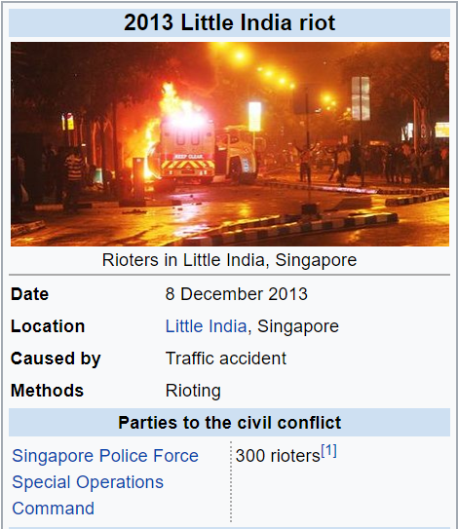
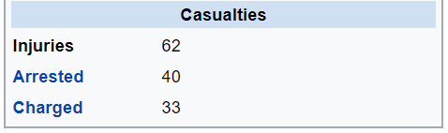
Little India Riot – Case Example
Assuming that the persons involved in the riot are twitter users and sentiments were already being shared prior to incident
If the sentiments and the location of these users were known earlier….could this incident have been prevented?

Slide 7
Methodology

Slide 8
How are we going to solve it
Geotagged data tell us where a person is when they publish the tweet
We will develop a tool that will mine a live stream of tweets containing specific terms and hashtags
Tweets that contain geographic coordinates will be stored in a geodatabase for analysis
The tool will also generate kernel density maps based on the geotagged tweets on the topics/issues of interest that we are interested in

Slide 9
Methodology
Use tweepy module and arcpy to mine and analyse a live stream of tweets
01
Extracting tweet geographic coordinates with tweepy
02
Creating the kernel density map
03
Building a tool/model to automate linking incident and hotspot layers to respective response units

Slide 10
Methodology
Use tweepy module and arcpy to mine and analyse a live stream of tweets
01
Install Tweepy
Create Twitter Application
Create SpatialReference to retrieve coordinates of tweets
Collect the location of tweets under the hashtag into the existing geodatabase
Extracting tweet geographic coordinates with tweepy

Slide 11
Methodology
Use tweepy module and arcpy to mine and analyse a live stream of tweets
02
Add Tweets feature class from geodatabase as a layer
Select a shapefile that users want to link points with
Use Spatial Join to Join the Tweets point with the shapefile
Use Arcmap’s Kernel Density Tool to create the points’ kernel density
Creating the kernel density map

Slide 12
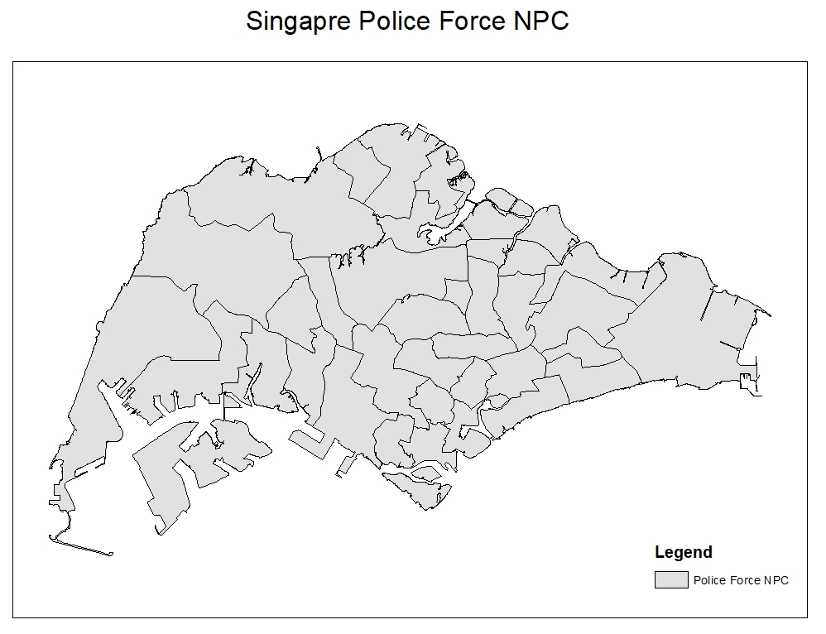
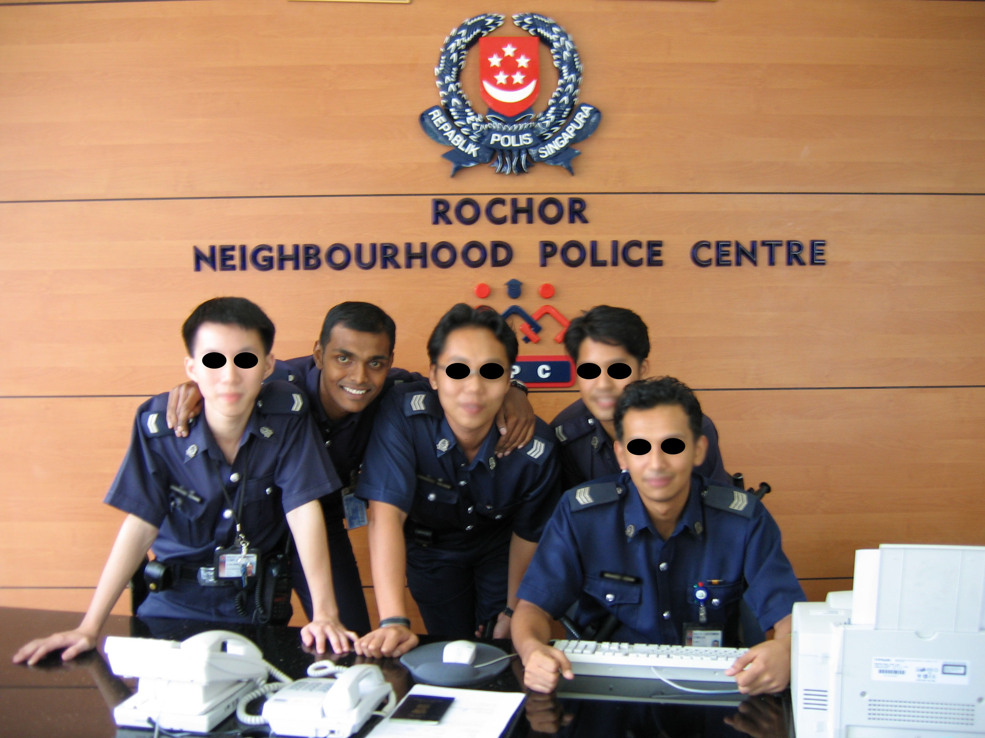
1. NPC Area District
Neighourhood Police Centre
Data source: data.gov.sg

Slide 13
Methodology
Use tweepy module and arcpy to mine and analyse a live stream of tweets
03
Building a tool/model to automate linking incident and hotspot layers to respective response units
Select the areas in the shapefile that have tweets located
Use extract by mask to extract the areas from Kernel Density Map

Slide 14
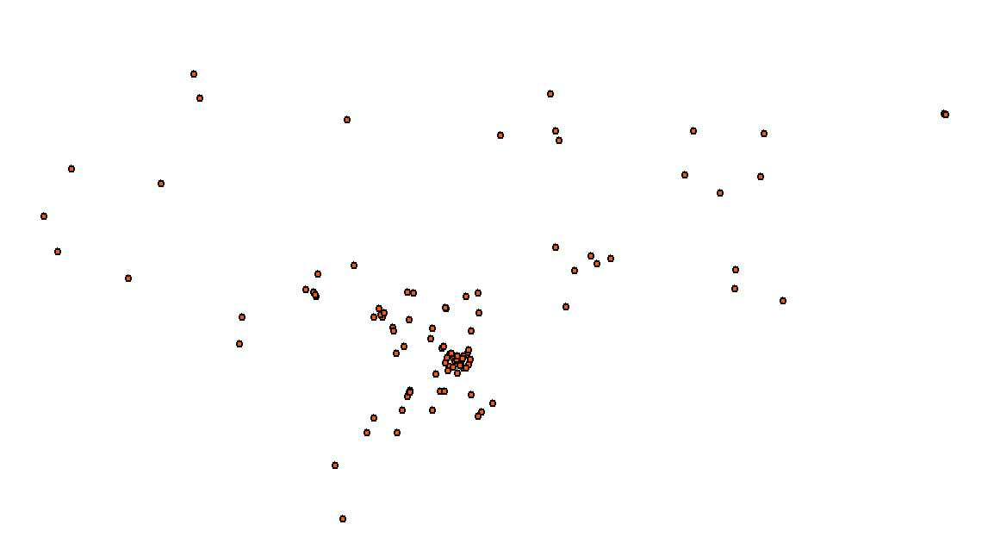
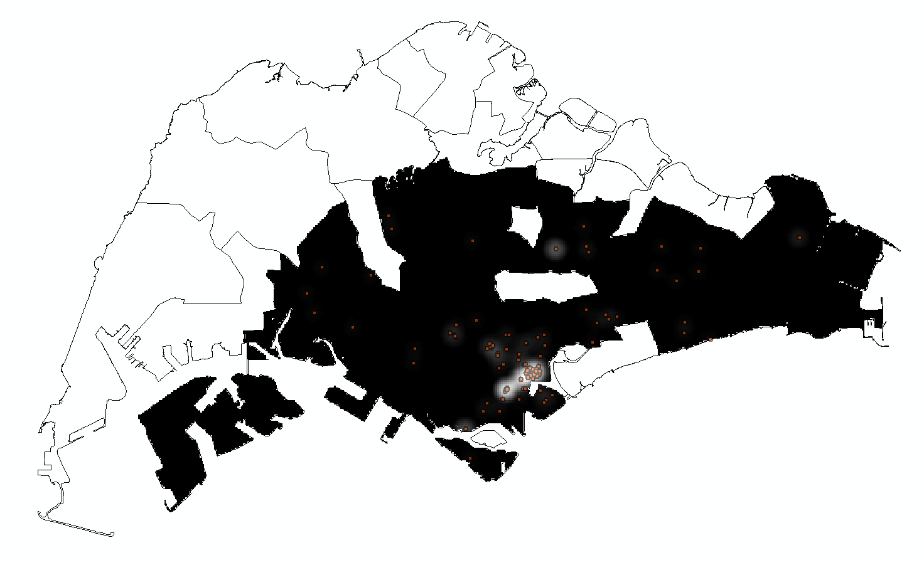
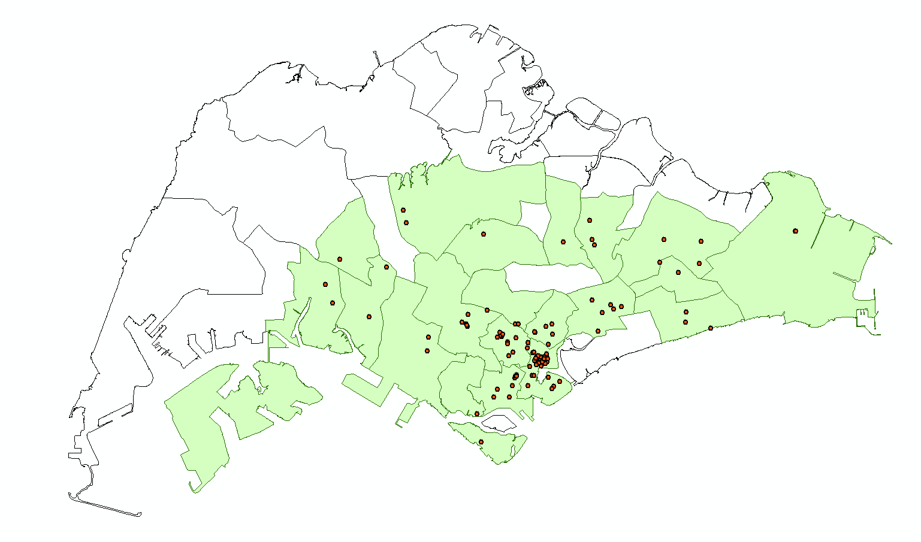
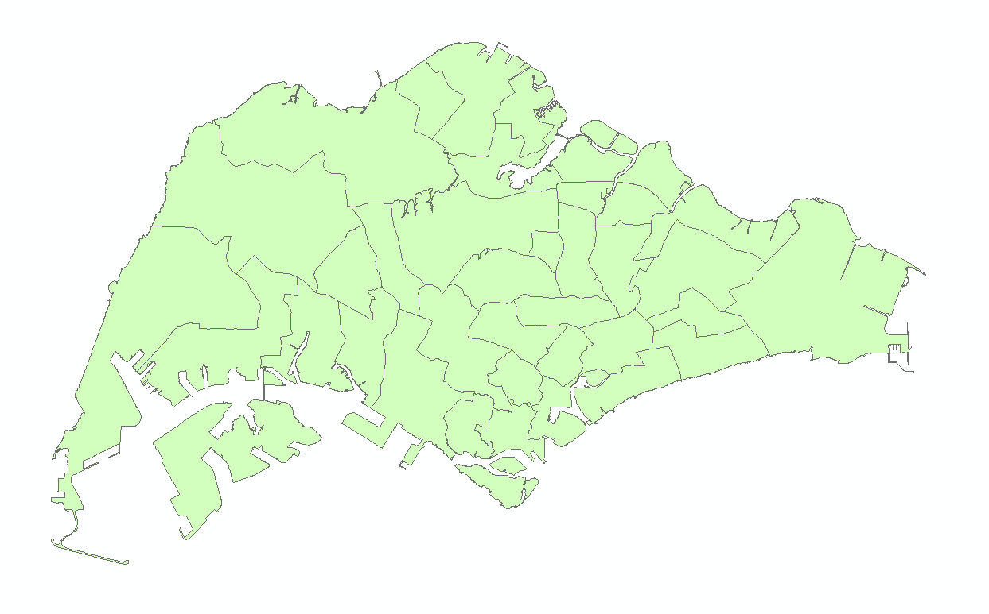
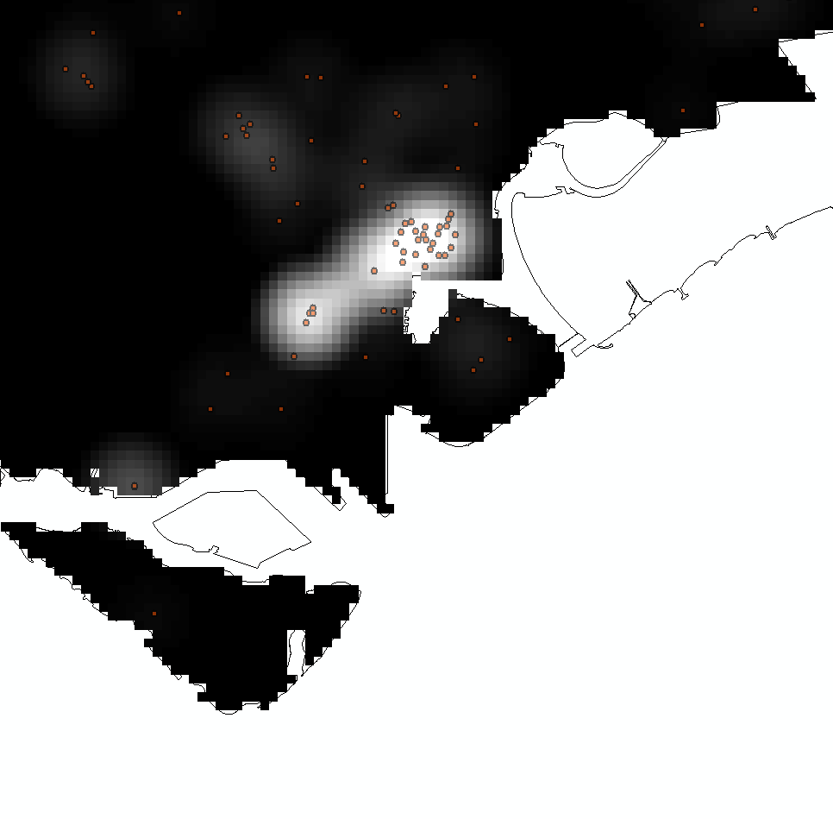
Work Flow
POINTS
SELECT
the area that have points located
CUSTOMIZE
Kernel Density Map
BOUNDARY

Slide 15
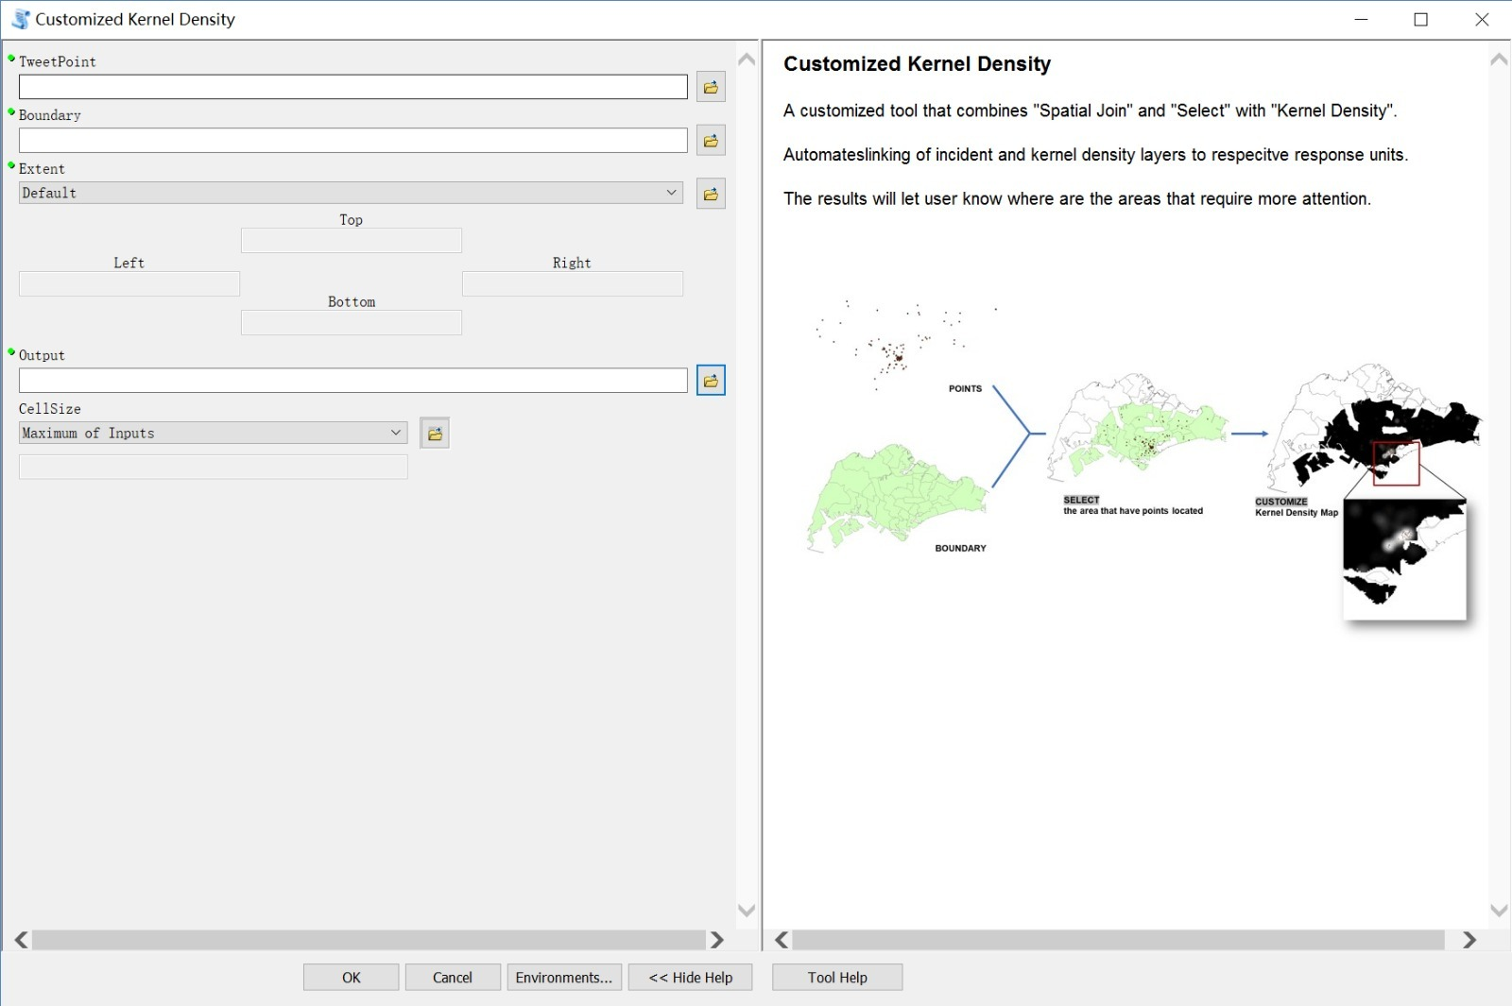

Slide 16
Results

Slide 17
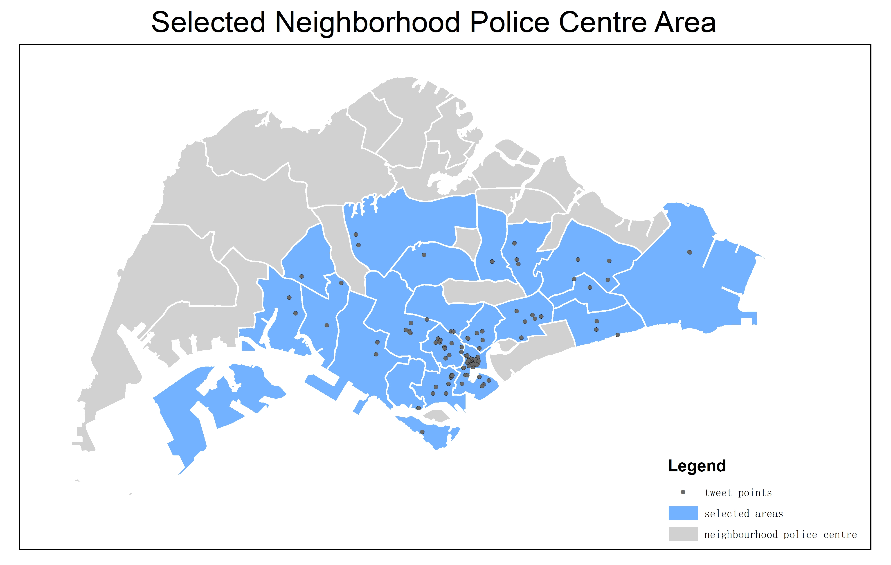
Geolocated tweets are mapped in selected NPC areas showing the distribution of tweets across Singapore

Slide 18
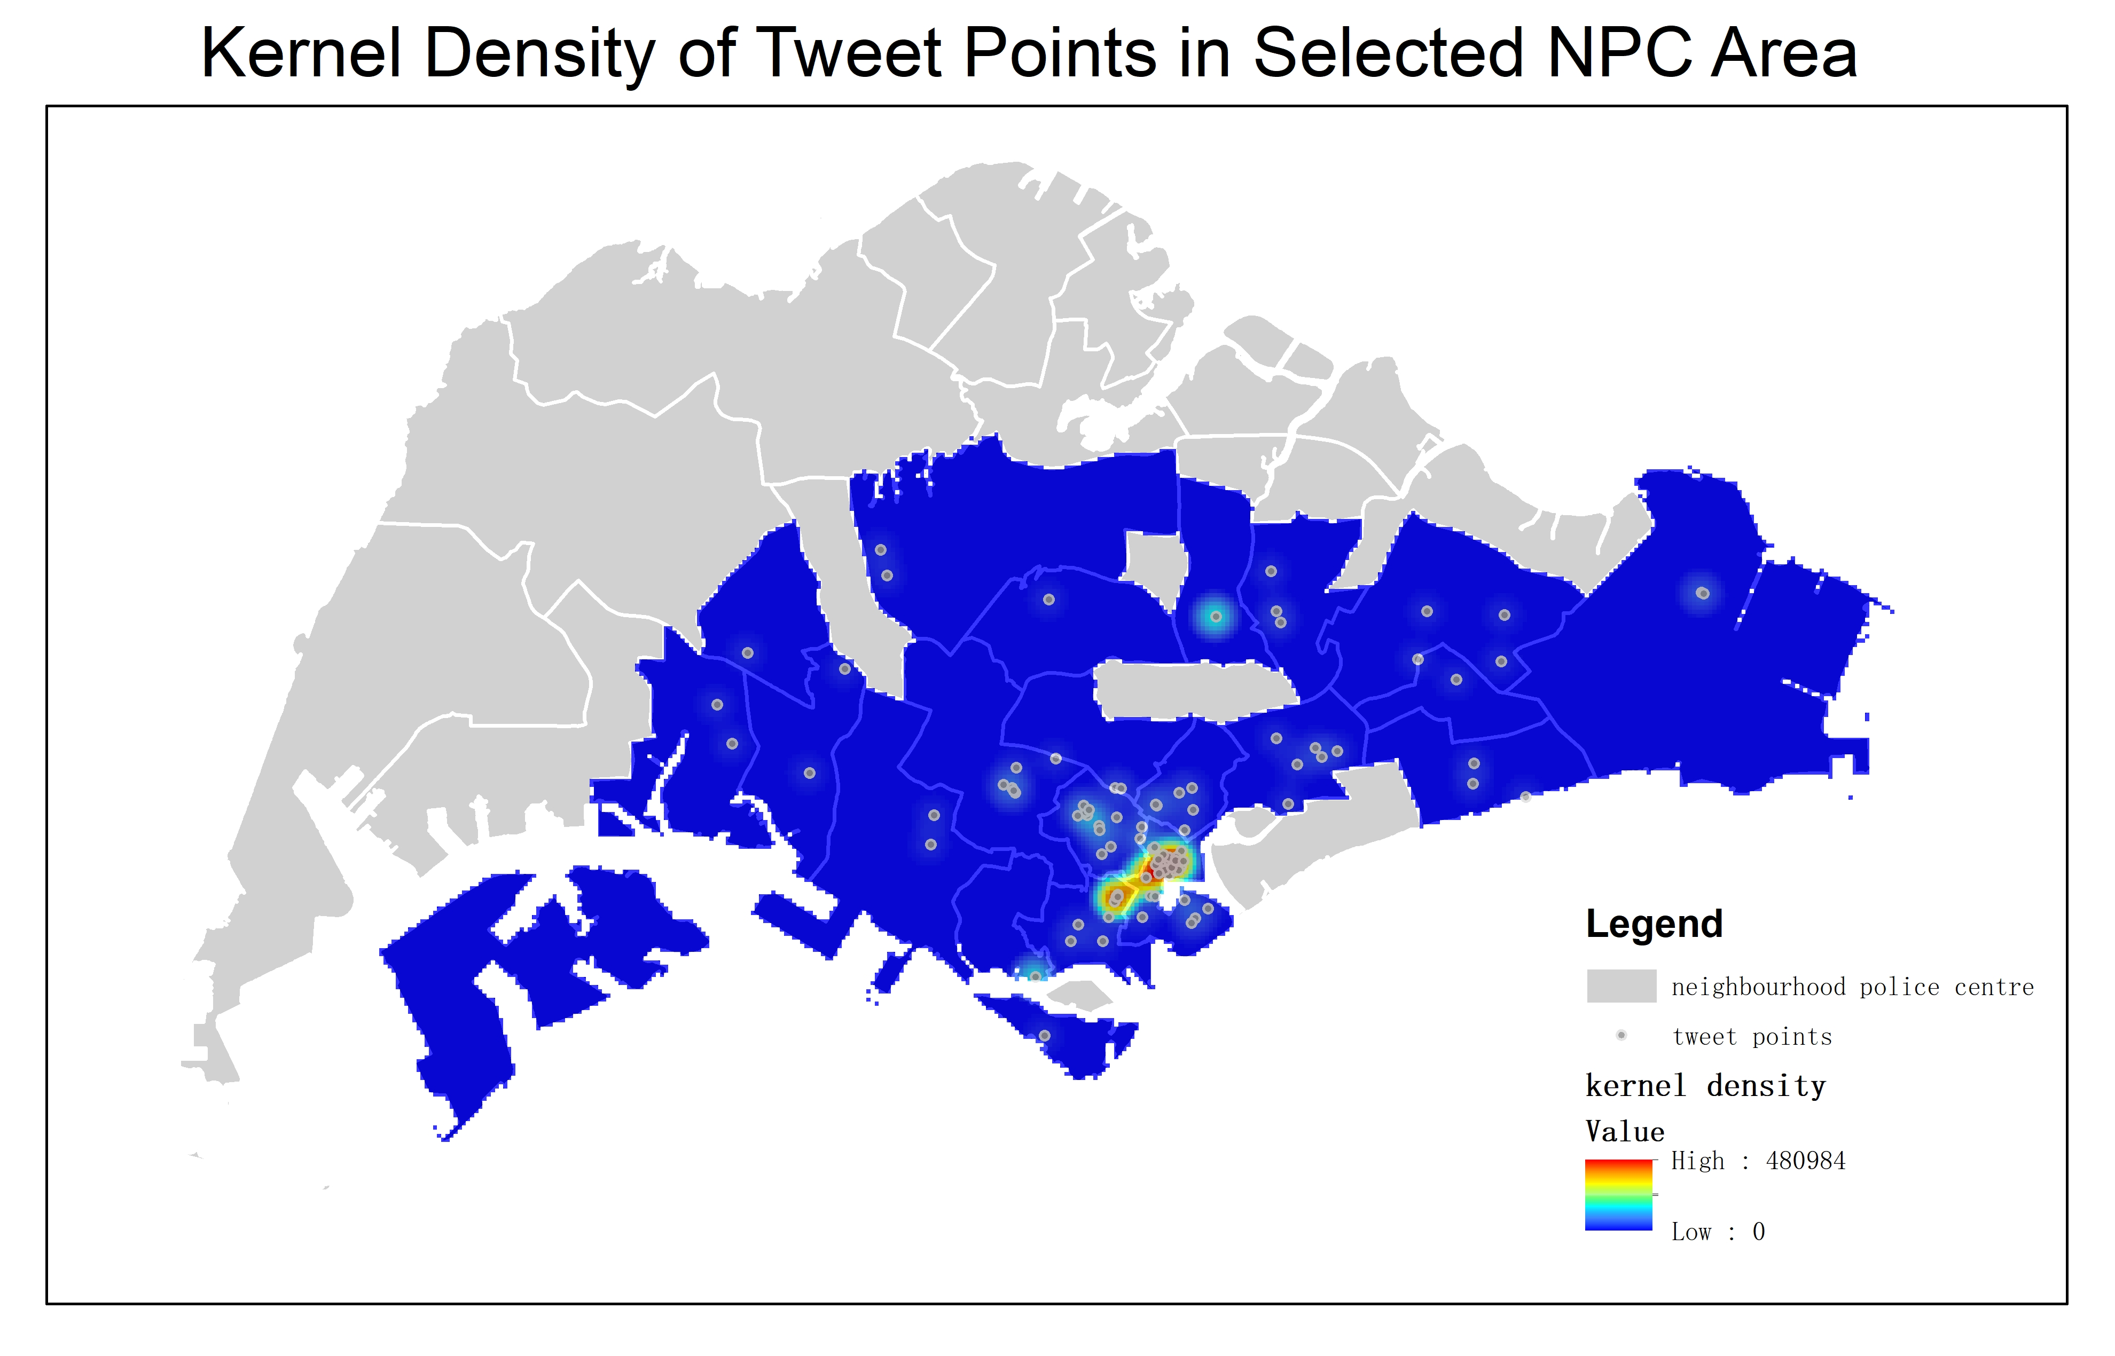
Narrows down to areas where tweets are more clustered
Facilitates resource allocation

Slide 19
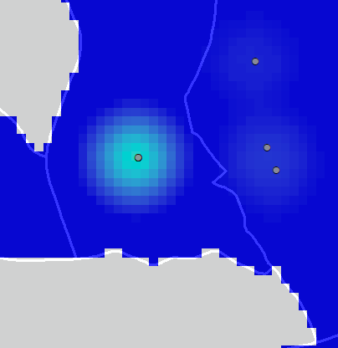
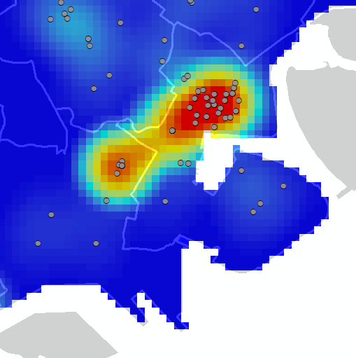
WHY does this “single” point show a higher kernel density than other single points?
The point represents multiple tweets at a single point either by one or many persons. Without doing kernel density analysis, these tweets at the same location would have appeared as a single tweet

Slide 20

Limitations
The number of tweets collected is small and therefore may not be representative
Twitting tourists may not have been excluded
The number of tweets were used instead of twitter users
Geolocated tweets are only a small subset of the total amount of tweets and may also represent a particular user group, ready to share location information

Slide 21
Conclusion
Although only about 2% of tweets contain location information, we can still get a relatively good sensing of the spatial patterns of social media when monitoring large events over an extended period of time
If used together with the traditional sources of information, a better sensing can be obtained on the threat of public disorder
This tool is scalable as it can be extended and customized for use by other industry players

Slide 22
Future Enhancements
Collect the detailed text with the tweets that have location and do a word cloud to see what are the key concerns
Bring in other layers that will be relevant for the project like hospitals or other emergency or response services in the event that they are needed for a situation

